Slide 1
Project Title: Number Guessing game Group Number: 2 Team Members : OM, Samira , Anish Submission Date: 23/10/25 Submitted To: Anish Project Type: GAME

Slide 2
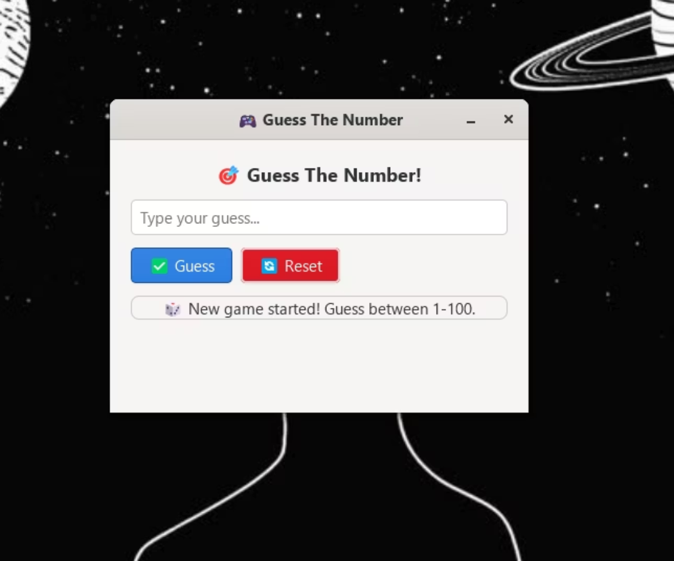
Numbers Guessing Game
Mini Project Presentation
Hello everyone! First of all I'll introduce my self. My self samira vadke. Our group is group no. 2. I'll be presenting out mini project which is numbers guessing game.

Slide 3
Project Overview
Main Idea & Goal
The Concept
The Goal
The main idea of this project is to create an interactive game where the computer randomly selects a number between 1 and 100, and the player has to guess it. After each guess, the game provides feedback like "Too high", "Too low", or "Correct!", until the player finds the right number.
The goal of this project was to make a fun and simple logic-based game while also learning how to design a Graphical User Interface (GUI) using the GTK library in C.

Slide 4
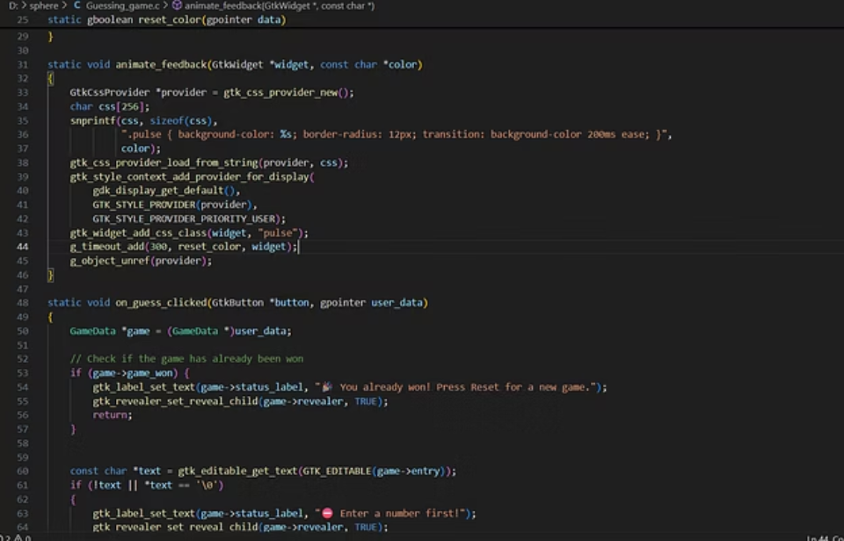
Technologies & Tools Used
Programming Language
GUI Framework
Development Environment
We have build this project using c programming language.
GTK (GIMP Toolkit) — used for building the graphical user interface such as buttons, labels, and entry boxes.
vs code, MSYS2 (UCRT64) — used for compiling and running the GTK-based C program.
Libraries Used:
gtk/gtk.h → for GUI components
stdlib.h and time.h → for generating random numbers.

Slide 5



Team Collaboration
This project was completed as a team effort.
Om Shinde
Anish
Samira Vadke
Our team lead have done Base code and core logic
Has done Designing user interface (UI)
I was responsible for making the report and adding comments to the code
Together, we ensured that the application was both functional and user-friendly.

Slide 6
daily updates
📅 17th October 2025 (Friday)
Project assigned to the team.
📅 18th October 2025 (Saturday)
Tasks distributed:
Om: Base code and core logic
Anish: Designing user interface (UI)
Samira: Comments and report documentation
📅 19th October 2025 (Sunday)
Om completed the base code and core logic implementation.
📅 20th October 2025 (Monday)
Anish completed the UI design.
Samira complete comments and the report work.
Om tested and finalized the full project integration.
📅 22nd October 2025 (Wednesday)
Samira updated the final report.
Final version of the project prepared for submission.

Slide 7
Demonstration of the Project
Now, I'll demonstrate how the game works. LIVE
01
02
Game Start
Player Input
When the program starts, a window appears titled "Guess the Number".
The player enters a number between 1 and 100 in the input box.
03
04
Guess Button
Feedback
On clicking the "Guess" button, the game checks if the entered number is correct.
If it's too high or too low, the program displays feedback accordingly.
05
06
Success Message
Reset Option
When the player guesses correctly, a congratulatory message appears along with the total number of attempts.
The "Reset" button can be used to start a new game with a fresh random number.
This creates an engaging and interactive experience for the user.

Slide 8
Key Learnings
From this project, we learned:
GTK Library Mastery
Event Management
How to use the GTK library to design a desktop GUI application in C.
How to manage events and callbacks, such as button clicks.
Frontend-Backend Integration
Code Quality
How to connect frontend (UI) with backend logic in C programming.
The importance of modular coding, code readability, and user experience design.
And most importantly, how small projects like this can strengthen understanding of logic building, debugging, and event-driven programming.

Slide 9

Conclusion
To conclude, this project gave us hands-on experience with GUI development in C, and helped me build a complete, interactive, and enjoyable application from scratch. we would like to thank our team for the cooperation and amazing support.
Thank you!

